Slide 1


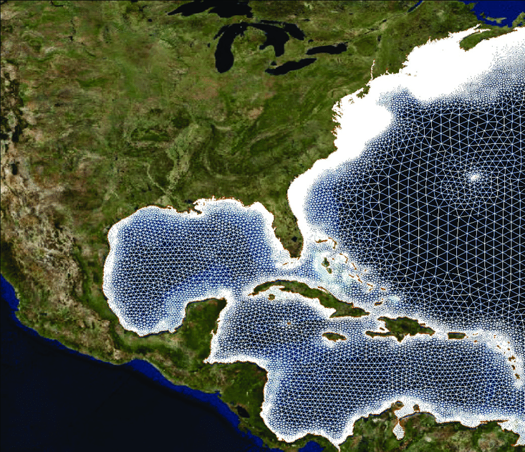
NC STATE ESTCP Updates
Jenero Knowles & JC Dietrich
15th October 2024

Slide 2
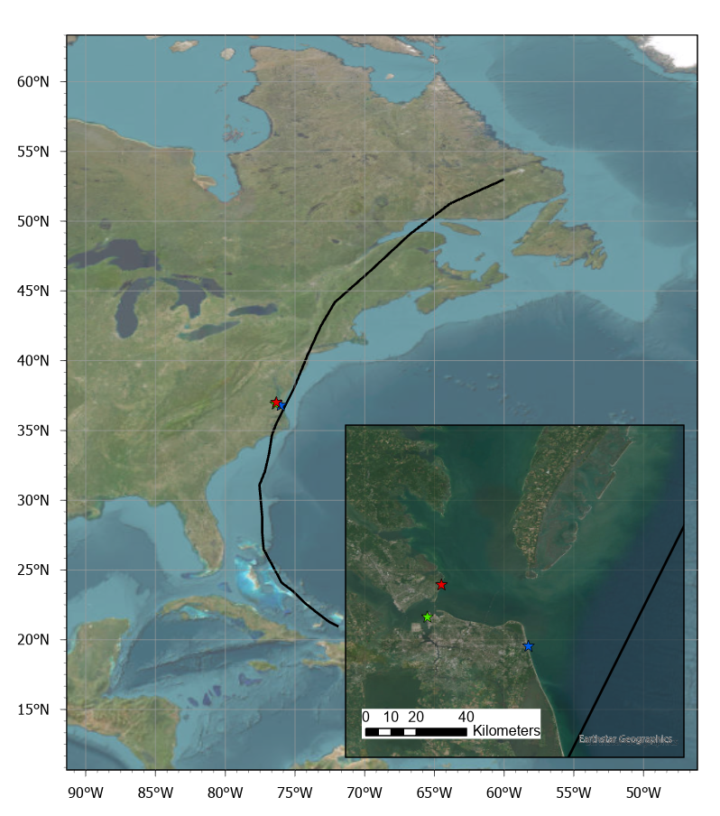
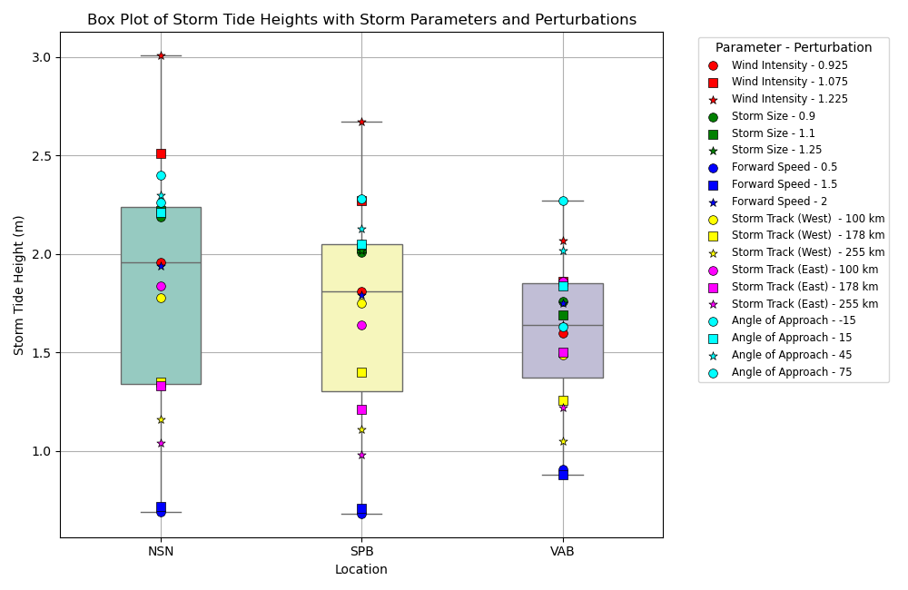
Work In Progress
Notes:
Hypothesis: the range of magnitudes will be larger at an in-land location like a bay, due to the combined effects of storm and geographic conditions.

Slide 3
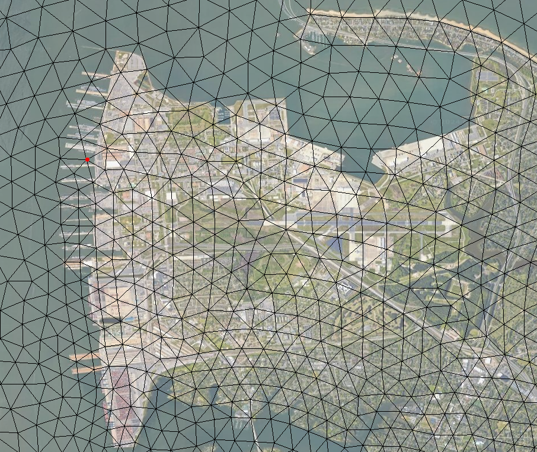
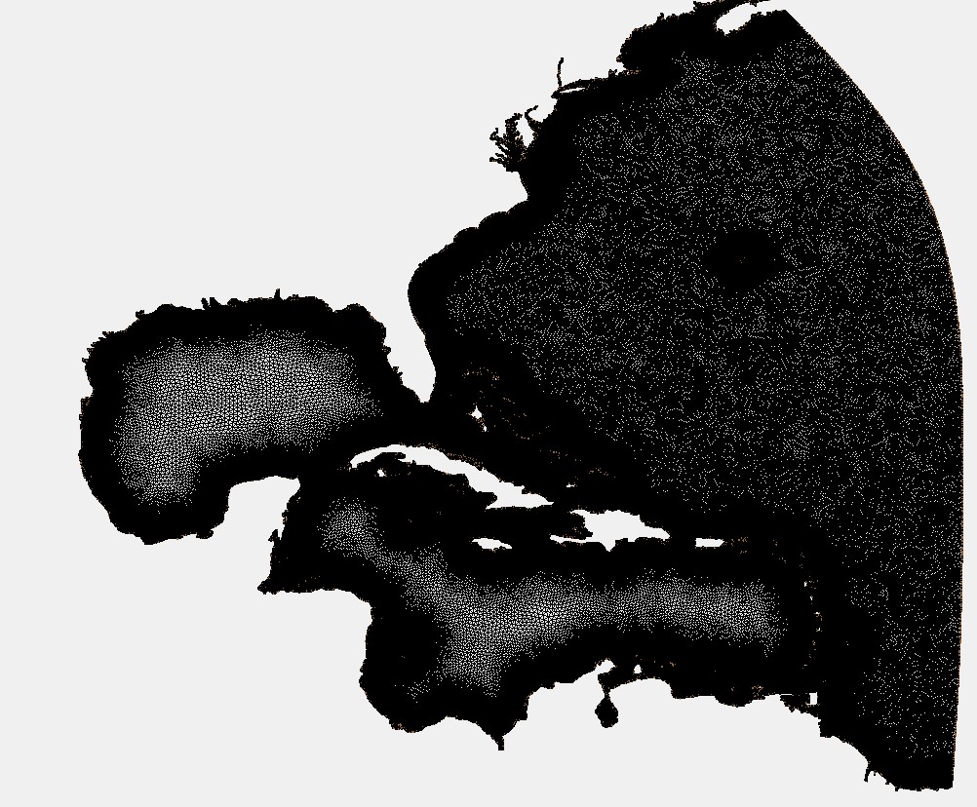
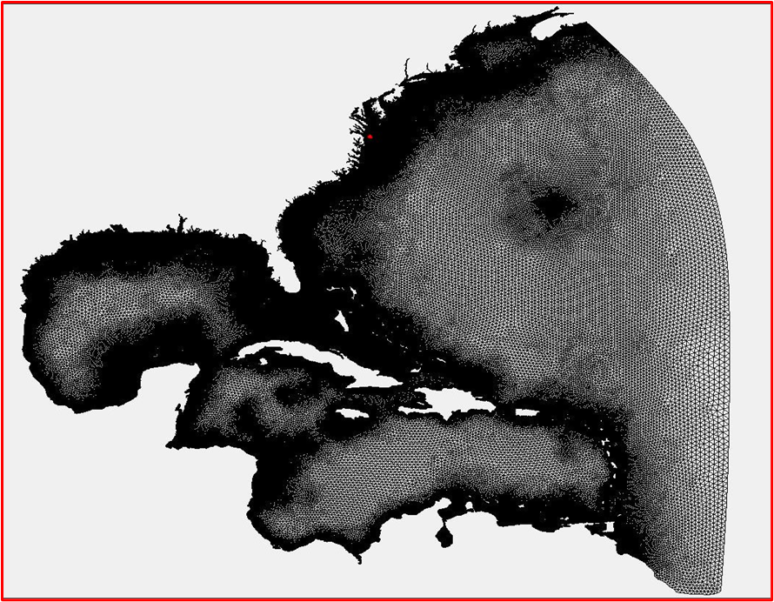
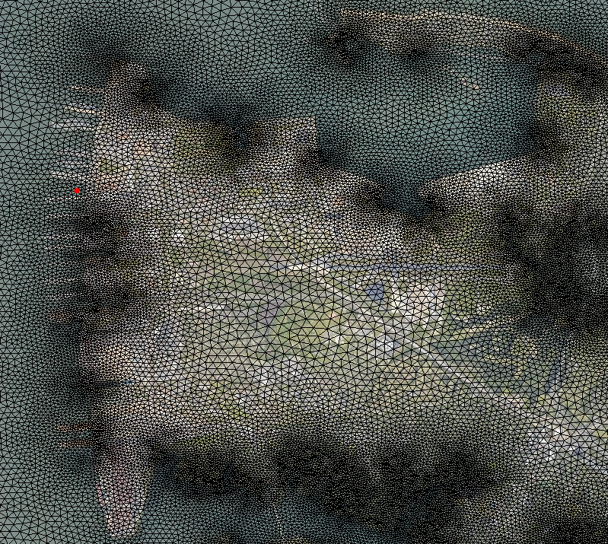
Lessons from NSN
HSOFS Mesh (3.6 Million Elements)
NSNv4 (2.5 Million Elements)
Notes:
500m min vs 20m min
Computationally not efficient
6492 vertices in NSN boundary == 0.003%

Slide 4
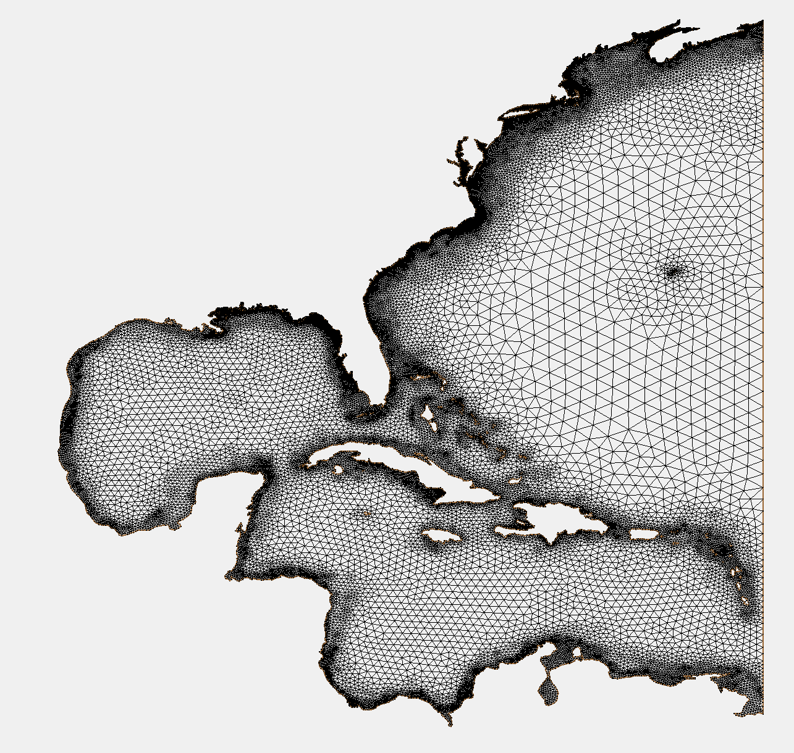
Plan for TAFB
TAFB ( **GOAL** 35k Elements)
Levels | Resolution Range (m) | # of Elements
TAFB | 5 to 100 | 10k
Florida Panhandle | 50 to 1k | 15k
Gulf | 1k to 30k | 5k
Global | 30k to 50k | 5k
Total | - | 35k
Notes:
TAFB== 30% of elements

Slide 5
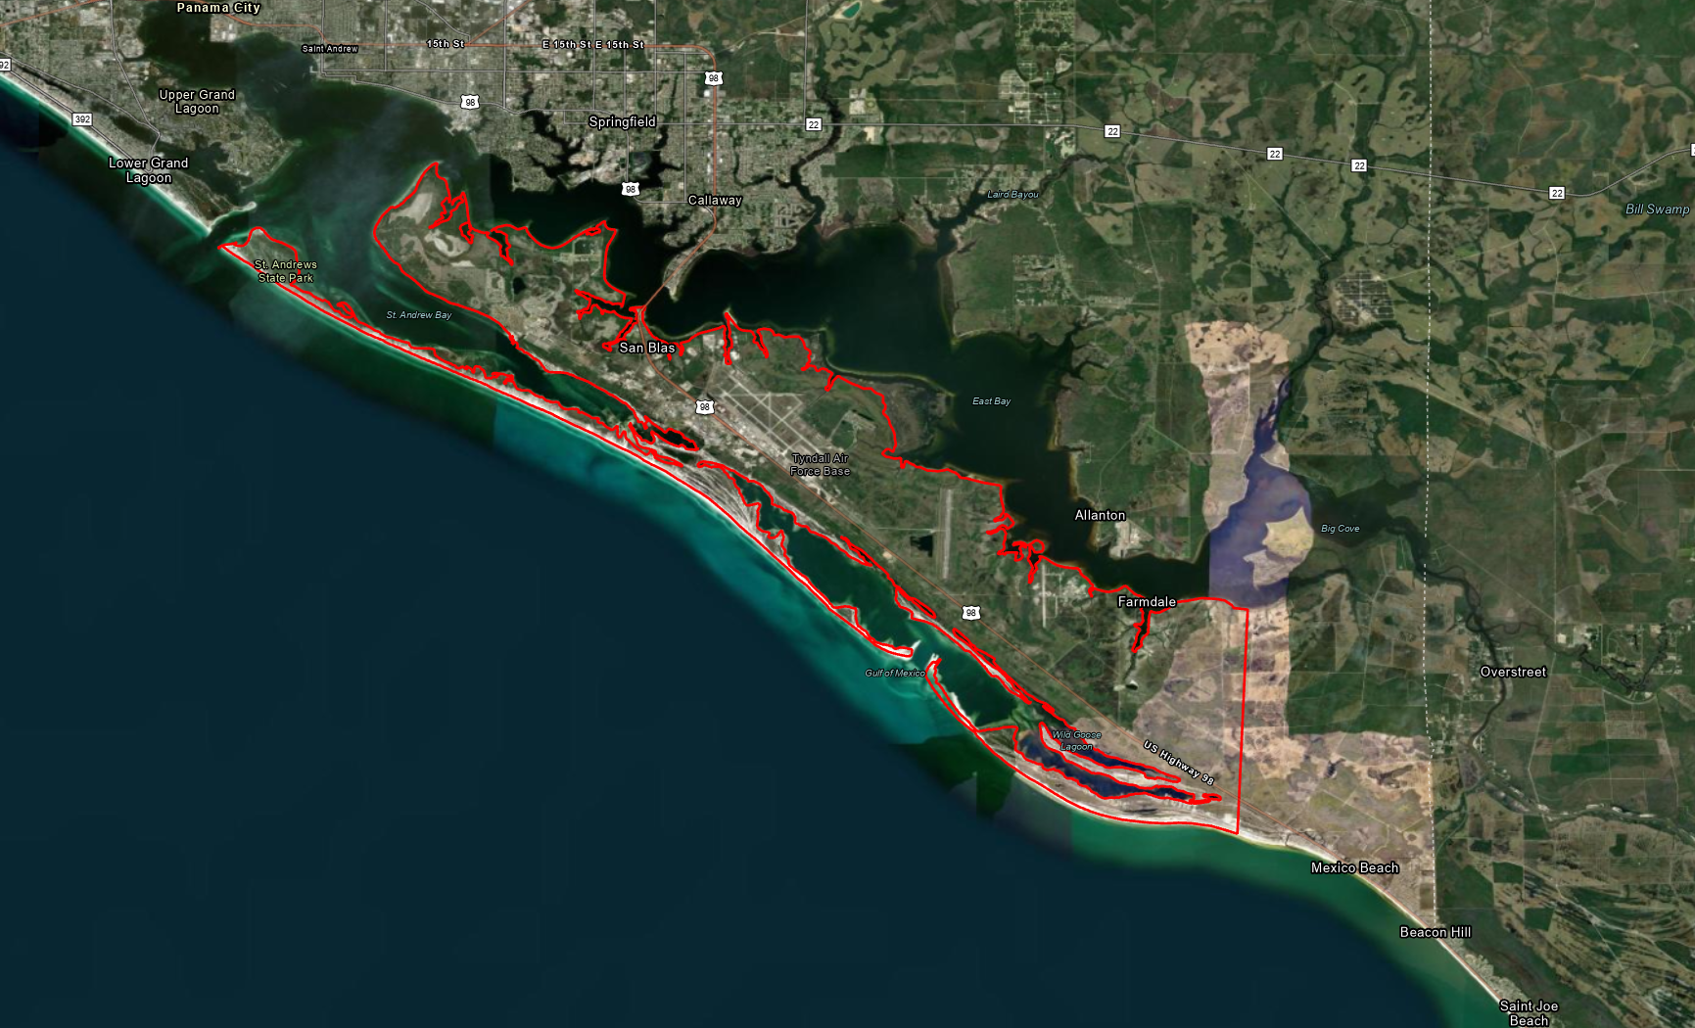
Temporary Boundary for TAFB
Notes:
Revised Boundary

Slide 6
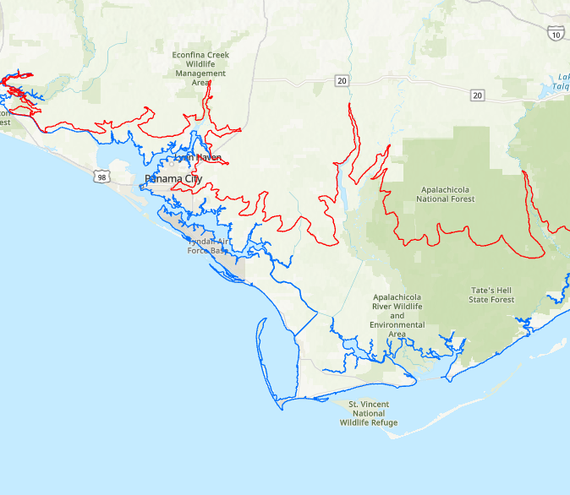
Coastlines and Floodplains

Slide 7


Email: jsknowle@ncsu.edu
Website: ccht.ccee.ncsu.edu

